Slide 1
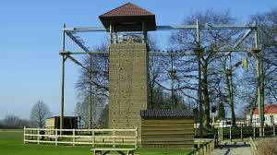
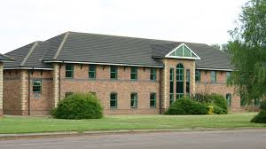
PGL Caythorpe Court 27th June – 29th June 2018

Slide 2
Staffing
Mrs Hickman
Miss O’Donnell
Miss McBride
Mr Robinson
38 children in groups of 9 or 10.

Slide 3
Reasons for the visit:
Children get new experiences
Learn to be independent
Team building skills
Problem solving
Challenge

Slide 4
Expectations
The children do not need to do all the activities if they don’t want to but will be encouraged.
Behaviour in the rooms expected to be safe, sensible, respectful of others.
Remind children that PGL are zero tolerance and any silly behaviour they will be removed from the activities.
Expected to listen to adults, instructions and respond to requests.
Respect that there are other schools and be respectful.

Slide 5
What’s it all about?
http://www.pgl.co.uk/en-gb/school-trips/resources/promotional-videos/primary-schools-videos

Slide 6
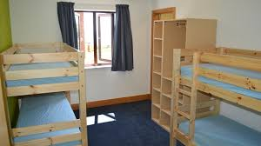
Rooms
Some rooms of 6
Some of 4
Bathroom per room
We have kept friends together where we can!

Slide 7
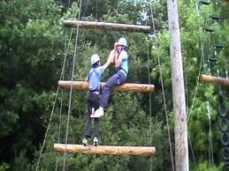
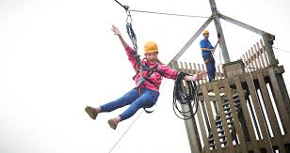
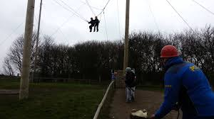
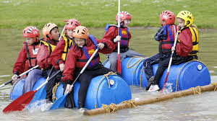
Activities
Jacob’s Ladder
Giant Swing
Zip Wire
Raft Building
Plus 4 smaller activities

Slide 8
Format for the day:
Wednesday – all arrive for start of the school day at 8.40 – go straight to the hall.
Leave at around 9.00 – 9.15
Arrive at around 12.15
Have lunch/meet leaders/go to rooms
Start activities at 2.20pm
Friday leaving after lunch at around 1pm to arrive back at school at around 3.10pm (traffic permitting)

Slide 9
Important things to remember:
All children need their packed lunch separate from their luggage in a plastic bag so all rubbish can be binned.
If children are on wet activities on Wednesday afternoon they need to be in pond clothes with dry kit and towel in backpacks ready.
Only £5 spending money for the shop – 1 visit only.
No mobile phones, valuables etc.
Cameras are taken at your own risk.
Bin liner for stinky pond gear – please label with a name tag.
Anyone who suffers from travel sickness needs to bring appropriate medication for both the travel and return journey – put Friday’s meds in an envelope with their name on and time it needs to be given.

Slide 10
Other information:
Security all night, rooms are in a building security coded.
Emergency Direct Caythorpe Court – 01400273733
Insurance PGL’s own and Local Authority

Slide 11
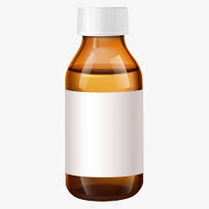
Medicines
All medicine in a small plastic bag
Make sure name is on the bottle – hand to Mrs Hickman on Wednesday before leaving.
Please send a syringe or spoon to administer
Please add clear instructions for administering.

Slide 12
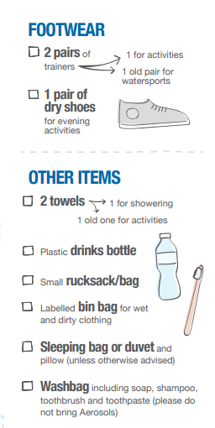
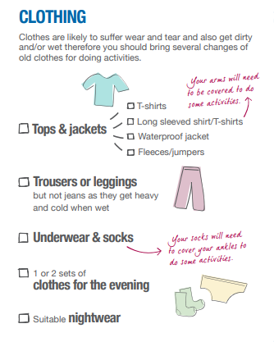
Kit list
No bedding needed!!

Slide 13
Questions

