Slide 1
Year 2 end of year Assessments Parents Meeting

Slide 2
Information
Show off week – normal practice in school – Assertive Mentoring includes tests (no stress and no panic)
Explanation how information is collected
Tests – will take place in May after Year 6 SATs
Scaled Score
Framework descriptors
Examples of questions
Ways to help your child
Opportunity to look at sample papers

Slide 3
End of Key Stage Assessments
Year 2 are assessed at the end of KS1 in line with the governments criteria and frameworks
The teachers conclude the children’s ability through Teacher Assessment – work in books and in provision, plus Tests that the government provide
At the end of KS1 the descriptors are not levels but
Working towards Age Related Expectations (WTS)
At Age Related Expectations (ARE)
Working at Greater Depth Standard (GDS)

Slide 4
Tests
The tests we use in school are
Maths
Paper 1: arithmetic
Paper 2: reasoning
Reading
Paper 1: combined reading prompt and answer booklet Paper 2: reading booklet and reading answer booklet
We do not use the Spelling, Punctuation & Grammar Test

Slide 5
Scaled Score
What is meant by ‘scaled scores’?
It is planned that 100 will always represent the ‘national standard’.
Each pupil’s raw test score will therefore be converted into a score on the scale, either at, above or below 100.
The scale will have a lower end point somewhere below 100 and an upper end point above 100.
A child who achieves the ‘national standard’ (a score of 100) will be judged to have demonstrated sufficient knowledge in the areas assessed by the tests.
Notes:
These are used by the teachers to inform their overall assessment of each child’s ability.
The government introduced them so that they can compare progress at the end of KS2

Slide 6
Key Stage One - Reading

Slide 7
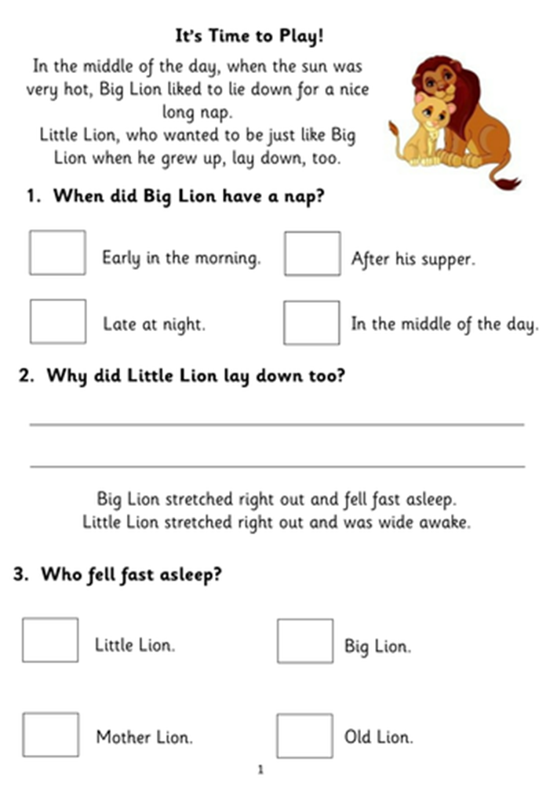
Example of Reading Paper

Slide 8
Key Stage One – Writing

Slide 9
Exemplification

Slide 10
Key Stage One - Maths

Slide 11
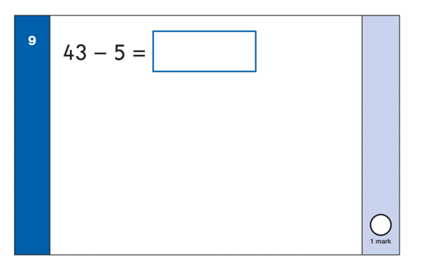
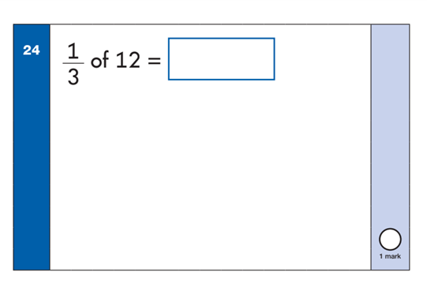
Arithmetic Paper examples

Slide 12
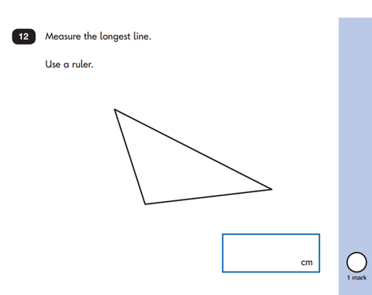
Reasoning Paper examples

Slide 13
How to help your child
First and foremost, support and reassure your child that there is nothing to worry about and that they should always just try their best. Praise and encourage!
Ensure your child has the best possible attendance at school.
Support your child with any homework tasks.
Reading, spelling and arithmetic (e.g. times tables) are always good to practise.
Remember that good readers become good writers! Identify good writing features when reading (e.g. vocabulary, sentence structure, punctuation).
Talk to your child about what they have learnt at school and what book(s) they are reading (the character, the plot, their opinion).
Make sure your child has a good sleep and healthy breakfast every morning!

Slide 14
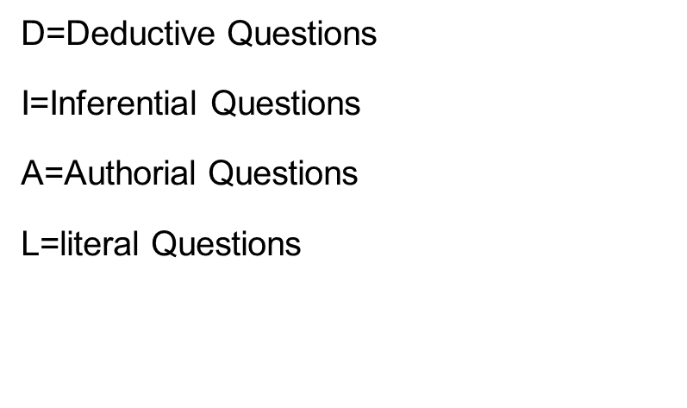
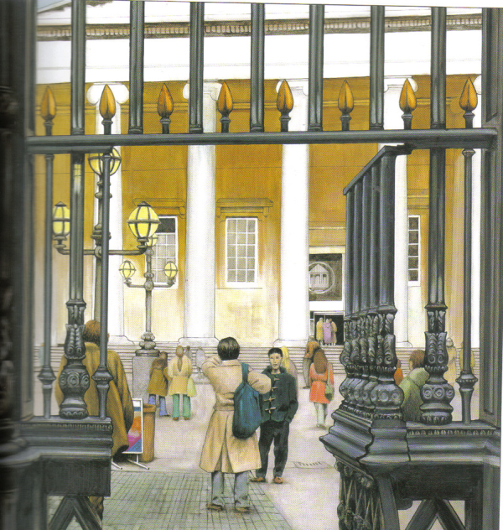
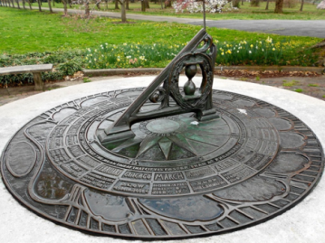
… more ways to help your child
Reading paper relies on inference and deduction type questions
DIAL questioning/ activities
Notes:
DIAL type activities

Slide 15
…more ways to help your child
R: How many ballet shoes are used each year by the Royal Ballet? How much does the Royal Ballet spend on shoes each year? What colour are the ballet shoes? How do they stay on the dancers' feet? What tools does the first worker use?
I: What is the camera being? Why does the screen go dark halfway through? Why does the Royal Ballet spend so much on shoes each year?
C: Why did the Royal Ballet make this video? (Focus on the word "support" at the end). What is unusual about how the director chose to shoot this video? (Perspective of the shoe). Why did the director chose to shoot this video from the perspective of a shoe?
www.mrspteach.com
Notes:
RIC activities

Slide 16
…more ways to help your child
Play times tables games.
Play mental maths games including counting in different amounts, forwards and backwards.
Encourage opportunities for telling the time = TV programmes, what time tea will be etc.
Encourage opportunities for counting coins and money e.g. finding amounts or calculating change when shopping.
Look for examples of 2D and 3D shapes around the home.
Identify, weigh or measure quantities and amounts in the kitchen or in recipes = BAKE
Play games involving numbers or logic, such as dominoes, card games.

Slide 17
Chance to look at the samples
Thank you for coming the staff are now available to show you the sample papers.

